Slide 1
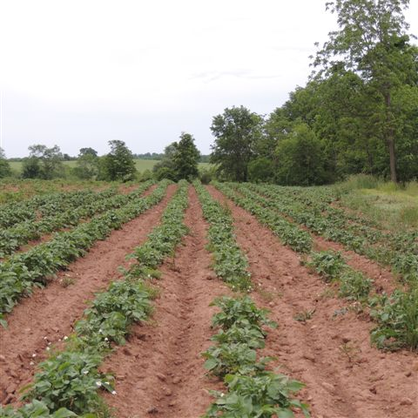
the economy of feminine
leadership for integration
and inclusiveness
APARIGRAHA: A
NEW ECONOMIC PARADIGM
FOR A CULTURE OF PEACE
GLOBAL COALITION FOR PEACE

Slide 2
CONTENTS
part i – TRANSFORMATION
part ii-- ECONOMIC SYSTEM OF MALE DOMINANCE
part III. - A NEW PARADIGM
part IV - SHOWING ITS VIABILITY

Slide 3
PART I
TRANSFORMATION
THE PERVASIVE VIOLENCE AND DEGRADATION OF HUMAN VALUES ARE RESULTING IN DESTRUCTION OF THE PLANET AND THREATENING THE HUMAN SPECIES

Slide 4
APARIGRAHA’S STRATEGY
a
MORAL TRANSFORMATION IS NECESSARY TO MAKE SOCIAL TRANSFORMATION possible
SOCIAL TRANSFORMATION MAKES
ECONOMIC TRANSFORMATION possible
ECONOMIC TRANSFORMATION WILL MAKE POLITICAL TRANSFORMATION possible
POLITICAL TRANSFORMATION will make
the advent of a new era possible

Slide 5
A NEW PARADIGM
a radical transformation needs to take place to change the course of events before destruction becomes inevitable and irreversible.

Slide 6
THE FEMININE ENERGY
Oral tradition and indigenous prophecies speak of a new era, when the masculine energy coming to the planet through the Himalayan mountains will give way to the feminine energy coming through the Andean mountains in the southern part of the american continent

Slide 7
are there any indicators that the feminine energy is entering the planet?

Slide 8
ONE INDICATOR
UNTIL VERY RECENTLY THE WESTERN WORLD WAS REGULARLY VISITED BY MALE YOGIS WHO DREW HUGE CROWDS IN ORDER TO RECEIVE THE TEACHINGS GIVEN IN A LECTURE FORMAT.
AT PRESENT, WE SEE THREE EMBODIMENTS OF THE FEMENINE ENERGY AND THEY ALL HAVE A DIFFERENT MODALITY; THEY DEDICATE TIME TO ONE PERSON AT A TIME UNTIL EVERY PERSON HAS BEEN CARED FOR.

Slide 9
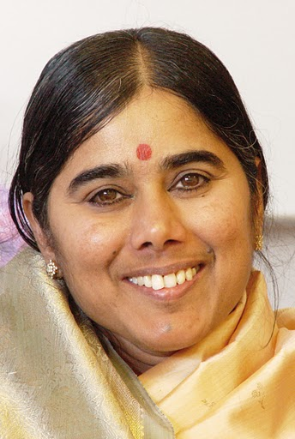
MOTHER MEERA
THE EMBODIMENT OF JNANA YOGA TO PACIFY VATA DOSHA & PREPARE SATTWA TO MOVE BEYOND GUNAS
NO WORD IS SPOKEN ONLY HER LOOK

Slide 10
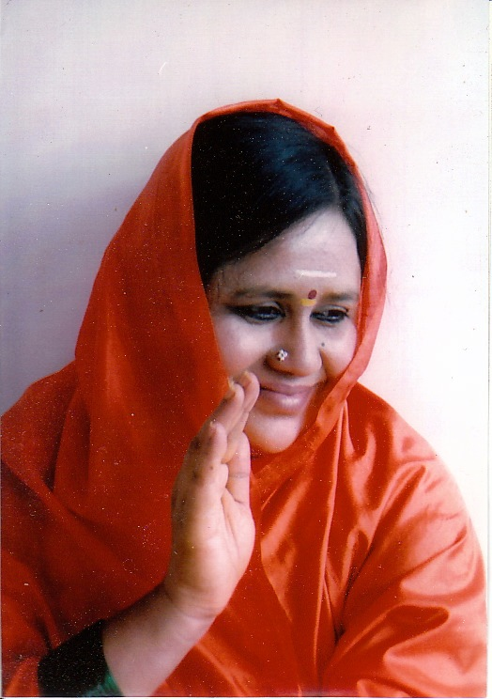
Amma sri karunamayi
EMBODIMENT OF KARMA YOGA TO PACIFY PITTA DOSHA & MOVE RAJA GUNA TO SATTWA
ENACTS TRADITIONAL VEDIC TEACHING

Slide 11
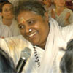
amritanandamayima
EMBODIMENT OF BHAKTI YOGA TO PACIFY KAPHA DOSHA & MOVE TAMA GUNA TO RAJA
HUGS EVERYBODY WITH LOVE

Slide 12
ANOTHER INDICATOR
there are also those working on the realm of maya (the earthly plane) to demonstrate the benefits of love and compassion with positions of power, as those we have seen working on the spiritual realm using their spiritual power

Slide 13
What does that mean?
They are working within the world of maya with those steeped in materialism, to awaken in them a primivial human sentiment of compassion towards each other

Slide 14
female presidents
BRAZIL’S PRESIDENT ARGENTINA’S PRESIDENT
Dilma rouseff cristina fernandez

Slide 15
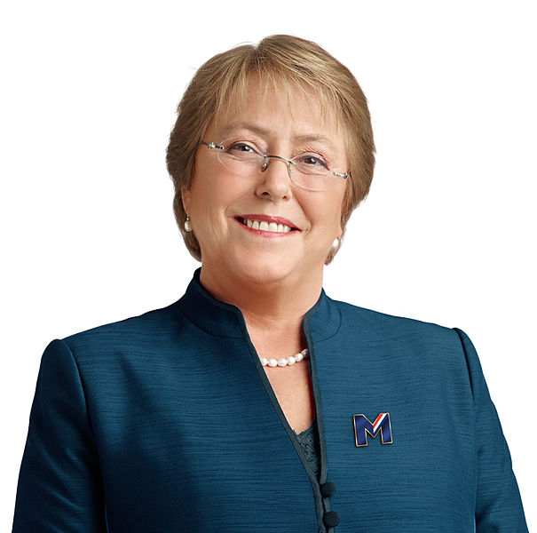
Present and recent
MICHELLE BACHELET
Chile’s president
ADINA BASTIDAS
Venezuela’s Vpdt. 2002

Slide 16
PART II
AN ECONOMIC SYSTEM OF MALE DOMINATION orchestrated by an overpowering elite that dictates the rules of the game

Slide 17
YOGA AND ECONOMICS
the prevalent economic paradigm based in male dominance is one of the main causes of the present state of affairs. a new economic paradigm with yogic principles and feminine values at its core can become the agent of proper transformation .

Slide 18
WARNINGS WERE IGNORED
THE FOUNDERS OF THIS COUNTRY AND THEIR MODERN SUCCESSORS FORESAW THE EXTREME DANGERS OF THE ECONOMIC SYSTEM CALLED CAPITALISM.

Slide 19
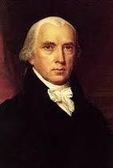
James Madison
Political Observations, 1795
Of all the enemies to public liberty war is, perhaps, the most to be dreaded because it comprises and develops the germ of every other. war is the parent of armies; from these proceed debts and taxes …………
KNOWN INSTRUMENTS FOR BRINGING THE MANY UNDER THE DOMINATION OF THE FEW No nation could preserve its freedom in the midst of CONTINUAL WARFARE.
19

Slide 20
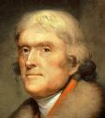
Thomas Jefferson
1802
”I believe that banking institutions are more dangerous to our liberties than standing armies. If the American people ever allow private banks to control the issue of their currency, first by inflation, then by deflation, the banks and corporations that will grow up around the banks will deprive the people of all property until their children wake-up homeless on the continent their fathers conquered."
20

Slide 21
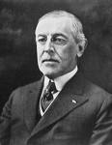
WOODROW WILSON
1921-
“We have come to be one of the
worst ruled, one of the most
completely controlled and dominated Governments in the world-- no longer
a Government of free opinion, no longer a
Government by conviction and vote of the majority, but a Government by the opinion and duress of small groups of dominant men.
A great industrial Nation controlled by its system of credit. Our system of credit is concentrated. The growth of the Nation and all our activities are in the hands of a few men.”
21

Slide 22
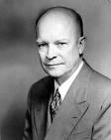
Dwight D. Eisenhower
“In the Councils of government, We must guard against the acquisition of Unwarranted influence, whether sought or unsought by the Military/industrial complex.
THE POTENTIAL FOR THE DISASTROUS RISE OF MISPLACED POWER WILL PERSIST.”
“EVERY GUN THAT IS MADE, EVERY WARSHIP LAUNCHED, EVERY ROCKET FIRED SIGNIFIES, IN THE FINAL SENSE, A THEFT FROM THOSE WHO HUNGER AND ARE NOT FED, those who are cold and are not clothed. This world in arms is not spending money alone, it is spending the sweat of its laborers, the genius of its scientists, the hopes of its children. Under the cloud of threatening war. it is humanity hanging from a cross of iron. “
22

Slide 23
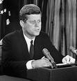
“IF WE DO NOT MAKE A PEACEFUL REVOLUTION POSSIBLE, WE WILL MAKE A VIOLENT REVOLUTION INEVITABLE.”
President John F. Kennedy
23

Slide 24
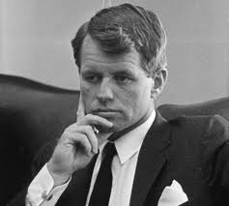
Robert Kennedy
"We will find neither national purpose nor personal satisfaction in a mere continuation of economic progress…………
We cannot measure national spirit by the Dow Jones Average, nor national achievement by the GDP… .
24

Slide 25
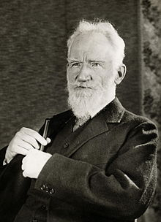
George Bernard Shaw
Capitalism has destroyed our belief in any effective power but that of self interest backed by force

Slide 26
J.M. Keynes:
(CONSIDERED FATHER OF MODERN ECONOMY)
Essays in Persuasion. (London 1932)pp. 369-72
“… For at least another hundred years we must pretend to ourselves and to everyone that FAIR is FOUL and FOUL is FAIR; for FOUL is useful and FAIR is not. Avarice, usury and precaution must be our GODS.”
26

Slide 27
THE SYSTEM
PROMOTES
ACCUMULATION - HOARDING
STIMULATES
SELFISHNESS & GREED
CREATES
FEAR
USES
LIES AND DECEPTION

Slide 28
EFFECTIVELY GOD HAS BEEN REPLACED WITH A NEW GOD “MONEY”
FIAT THE LATIN TERM THAT MEANS FAITH HAS COMPLETED THE CYCLE OF DECEPTION

Slide 29
foundation of capitalism
scarcity
competition
incentives
free market

Slide 30
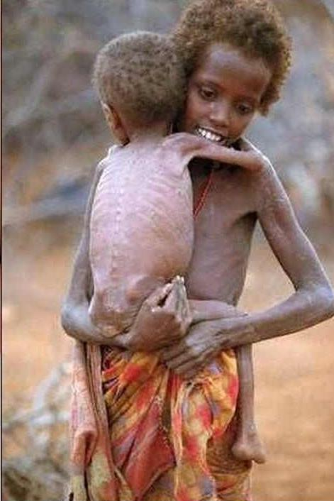
SCARCITY
STIMULATES FEAR
THE MOST CRIPPLING AND DESTRUCTIVE EMOTION
This is the result of
Scarcity

Slide 31
COMPETITION
STIMULATES ANTAGONISM SEPARATION
ALWAYS WILl BE A LOSER.
competition

Slide 32
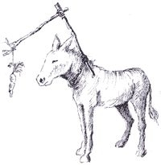
ECONOMIC INCENTIVES
STIMULATE SELFISHNESS AND GREED
DESTROYS SELF RESPECT AND SENSE OF RESPONSIBILITY
incentives

Slide 33
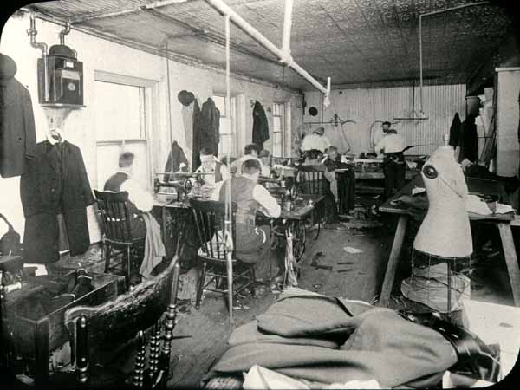
FREE MARKET
UNDERMINES ABUNDANCE
ENCOURAGING HOARDING & MANIPULATION TO INCREASE PROFIT FOR THE FEW AT THE EXPENSE OF THE MANY
33

Slide 34
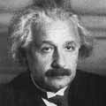
ALBERT EINSTEIN
THE GREAT EVIL AT HAND IS THE “ECONOMIC ANARCHY” OF CAPITALIST SOCIETY
WHICH CREATES A….
“crippling of the social consciousness of individuals.”
34

Slide 35
ASSESSMENT
CAPITALISM DOES INCREASE
PRODUCTIVITY SIGNIFICANTLY
IN THE MANUFACTURE OF MATERIALISTIC GOODS BUT AT THE COST OF HUMAN LIVES AND SOULS.
IT HAS SHAPED THE FABRIC OF SOCIETY CREATING PATTERNS OF BEHAVIOR COMPLETELY ALIENATED FROM THE INHERENT SPIRITUAL NATURE OF THE HUMAN BEING

Slide 36
PART III
A NEW ECONOMIC PARADIGM
APARIGRAHA
NON HOARDING NON ACUMMULATION

Slide 37
preamble
AS A RESULT OF CAPITALISM, SOCIETY IS NOW BASED ON MATERIALISM RATHER THAN HUMAN CENTERED VALUES.
SPIRITUALITY OR MORALITY HAS NO PLACE IN IT.
THIS PROPOSAL EXAMINES THESE ANOMALIES AND OFFERS INSTEAD A COMPREHENSIVE VIEW OF EXISTENCE.
WE STRESS THE NEED FOR MORAL TRANSFORMATION, AS A NECESSARY FIRST STEP.

Slide 38
WHY MORAL TRANSFORMATION?
DECADENCE OF SOCIETY HAS HISTORICALLY PROVEN TO BE THE CAUSE OF ENTIRE CIVILIZATIONS’ DISAPPEARANCE.
IT IS CAUSED BY A DESTRUCTIVE LIFESTYLE AND HABITS DUE TO LACK OF SELF-RESTRAINT OR PERSONAL DISCIPLINE AND
DISRESPECT OR IGNORANCE OF NATURAL, SPIRITUAL & COSMIC LAWS

Slide 39
THE FEMININE ENERGY & MORAL TRANSFORMATION
YOGA MEANS UNION, INTEGRATING OF POSITIVE ASPECTS OF THE FEMININE AND MASCULINE ENERGIES.
THAT IS THE SOURCE OF APARIGRAHA, THE NEW ECONOMIC PARADIGM.
YOGA UPHOLDS THE PRINCIPLE OF A UNIVERSAL DIVINE SPARK THAT IS THE ESSENCE OF EVERY SINGLE HUMAN BEING RECOGNIZING “UNITY IN DIVERSITY”

Slide 40
TOOLS FOR MORAL TRANSFORMATION
SPIRITUAL SCIENCES
SPIRITUALITY
YOGA - SPIRITISM
AYURVEDA TANTRA

Slide 41
SPIRITUALITY
IS A PHILOSOPHY OF LIFE THAT UPHOLDS:
THE CAPACITY TO DIFFERENTIATE BETWEEN THE REAL AND THE UNREAL;
THAT THERE IS ONLY ONE GOD WITH MANY NAMES; THAT RIGHT LIVELIHOOD IS THE WAY TO EARN A LIVING AND FULFILL OUR SOCIETAL RESPONSIBILITY; THAT ATTAINING THE PURPOSE OF OUR EXISTENCE IS THE MAIN CONCERN IN EACH LIFETIME; THAT DEATH IS NOT THE END OF OUR EXISTENCE BUT A STAGE IN A CONTINOUS CHAIN .
SPIRITUALITY CALLS US TO WIDEN OUR VISION TO EMBRACE THE COSMIC REALITY OF WHICH WE ARE PART YET UNDER CAPITALISM CONTINUALLY NEGATE.

Slide 42
YOGA
DHARMA - THE LAW – LOVE: THE MAIN LAW
NIYAMAS
RULES OF PERSONAL CONDUCT
PERSONAL - MORAL TRANSFORMATION
PURITY (SAUCHA), CONTENTMENT (SANTOSHA), DISCIPLINES (TAPAS), SELF-KNOWLEDGE (SWADYAYA), SURRENDER TO THE DIVINE (ISHWARA PRANIDHANA)

Slide 43
SPIRITISM
THE CAPACITY TO COMMUNICATE WITH THE SPIRITUAL WORLD RECOGNIZED IN THE PRACTICE OF YOGA WAS REINTRODUCED IN THE WESTERN WORLD IN 1850 BY ALLAN KARDEC.
ITS MAIN DEVELOPMENT HAS BEEN IN BRAZIL WITH 12,000 SPIRITIST CENTERS THAT PROVIDE FREE ASSISTANCE IN HEALTH AND RELATED ISSUES

Slide 44
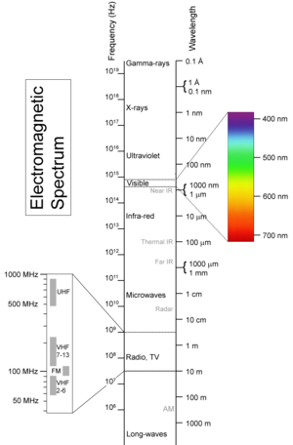
DIFFERENCE BETWEEN
SPIRITUAL & MATERIAL
THE LIMITATION OF MATERIALISTIC SCIENCE

Slide 45
WHY SPIRITUAL SCIENCES
MATERIALISTIC SCIENTISTS HAVE BLINDFOLDED US AND THEMSELVES, IN MANY WAYS BECOMING A SOURCE OF DESTRUCTION.
SPIRITUAL SCIENCES EXPAND OUR CONSCIOUSNESS AND TRUE KNOWLEDGE TO COSMIC LEVELS.

Slide 46
ESOTERIC ANATOMY
7th . Enlightenment Demonic nature
6th Awakening Resentment Delusion
5th Respect Imposition Tyranny
4th LOVE Hatred Envy
3rd Power Domination Exploitation
2nd Generosity Selfishness Hoarding
1st Courage Fear Anger Survival
DIVINE
SPACE
HUMAN
AIR
FIRE
WATER
ANIMAL
EARTH
DEVELOPED UNDEVELOPED

Slide 47
ANCIENT WISDOM
THE CADUCEUS
HERMES TRIMEGISTUS

Slide 48
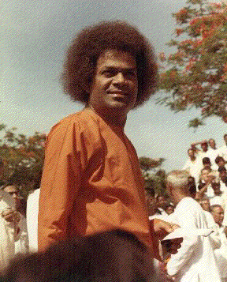
MODERN DEMOSTRATION
SRI SATYA SAI BABA

Slide 49
Successful, painless cures of “incurable” disease without anesthesia, pain killers, or sterilization
FACTUAL PROOF OFFERED BY SPIRITUAL SCIENCES
JOAO de DEUS - ABADIANIA - BRAZIL

Slide 50
PRINCIPLES
THAT CAN BRING ABOUT THE TRANSFORMATION
NOT SCARCITY ABUNDANCE
NOT COMPETITION COOPERATION
NOT INCENTIVES RESPONSIBILITY
NOT FREE MARKET PARTNERSHIP

Slide 51
NOT SCARCITY BUT
ABUNDANCE
based on trust
the term abundance should not be confused with excess or unlimited satisfaction of wants. mother nature’s abundance provides enough for everybody’s needs, not anybody’s greed.
ABUNDANCE
not scarcity

Slide 52
NOT COMPETITION BUT
COOPERATION
EVERYBODY WINS
collective work yields a higher output
than individual work.
when this becomes a practice, harmony
ensues; love and solidarity flourish.
cooperation
not Competition

Slide 53
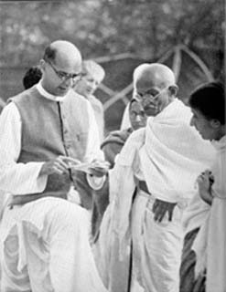
NOT INCENTIVES BUT
RESPONSIBILITY
CONCERN FOR ALL
“swaraj” self-rule, mahatma gandhi’s principle. the soul-force must be the guiding impulse. when it summons the will to act, it results in the right action.
not incentives

Slide 54
NOT FREE MARKET BUT
partnership
WIN –WIN SITUATIONS
solidarity based exchange creates satisfactory economic conditions for all parties. generates work, income, abolishes exploitation, domination and exclusion, protects ecosystems and promotes sustainable development.
not “free “ market

Slide 55
STAGE IV
SHOWING ITS VIABILITY

Slide 56
PREPARATION
UNDERSTANDING COSMIC REALITY
(Meditation)
SELF RESTRAINT
FRUGALITY
SIMPLICITY
lead the world change by changing yourself

Slide 57
EXPERIMENTAL MODELS
SHANTI YOGA ASHRAM COMMUNAL CELL
SPIRITUAL FOOD CSA COOPERATION
WOMEN’S PROGRAM SELF-GOVERNANCE
HOMELESS SUPPORT EQUALITY
LOVE OF NEIGHBOR NO INTEREST LOANS
ANACOSTIA HOURS SOVEREIGN CURRENCIES
LAND TRUSTS LAND FREEDOM
COOPERATIVE GAMES NEW EDUCATION

Slide 58
GLOBAL COALITION FOR PEACE
COMMITTED TO SPREADING THE NOTION OF NONVIOLENCE (AHIMSA) AND BASED ON THE PREMISE OF SWAMI SIVANANDA:
“AN OUNCE OF PRACTICE IS WORTH A TON OF THEORY.”
THE WORK FOR THE TRANSFORMATION OF SOCIETY TO MOVE TOWARDS A DIVINE LIFE DEMANDS THE APPLICATION OF PRACTICAL SOLUTIONS.
PEACE IS WITHIN EACH HUMAN BEING
58

Slide 59
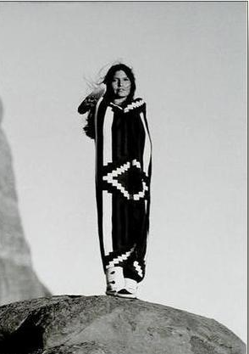
STAGE V
AGRICULTURE
RECOVERY OF THE COMMONS
FOOD & LAND
RESTORING THE COMMONS
Only after the last tree has been cut down
Only after the last river has been poisoned
Only after the last fish has been caught
Only then will you find that money
cannot be eaten.
Cree Prophecy

Slide 60
AGRICULTURE
THE MAIN HUMAN NEEDS TO GUARANTEE ITS SURVIVAL ARE AIR & FOOD. HUNGER IN THE WORLD MUST BE COMPLETELY ELIMINATED.
TRUE HUMAN SOLIDARITY DEMANDS THIS GLOBAL EFFORT TO BE ATTAINED.
TRUE SOVEREIGNITY CAN BE ATTAINED BY SELF-SUFFICIENCY. PROVIDING FOR EVERYBODY IS A LABOR OF LOVE. FARMERS SHOULD BE RECOGNIZED. A FORM OF AGRICULTURE THAT RESPECTS THE NATURAL LAW WILL PROVIDE AMPLE WORK FOR EVERYBODY.

Slide 61
THE FARMER
daniel webster: “cultivation of the earth is the most important
labor of man. when tillage begins, other art follows. the farmers,
therefore, are the founders of civilization.”
aparigraha will restore the farmer to its proper place in society - biodynamic farmer backbone of a spiritual (r)evolution

Slide 62
Federico Garcia Lorca, Spanish poet 1899-1936
“ THE DAY THAT HUNGER IS
ERADICATED FROM THE EARTH,
THERE WILL BE THE GREATEST SPIRITUAL EXPLOSION THE WORLD HAS EVER KNOWN. HUMANITY CANNOT IMAGINE THE JOY THAT WILL BURST INTO THE WORLD ON THE DAY OF THAT GREAT REVOLUTION."

Slide 63
FOOD LAND & ECONOMICS
a spiritual base for all societal approaches to life is necessary to avoid the total destruction of humanity and the planet. one method is biodynamic agriculture that heals the soil.
this paradigm considers eco-agriculture the main focus for reorienting the economy the conventional obsolete agronomy and the new transgenic seeds to be banned from the new society
Since food, besides, air is the fundamental first need of humanity and depends on land, its use and ownership becomes our focus for an economic alternative.

Slide 64
LAND OWNERSHIP
REQUIREMENT
AVAILABLE LAND
healthy soil
(Small farms)
PROBLEM
URBAN/ INDUSTRIAL SPRAWL
agribusiness/farming
APARIGRAHA CONSIDERS
RESTITUTION OF THE COMMONS
TO ALL THE PEOPLE O F THE LAND

Slide 65
RESTITUTION OF THE COMMONS
1st. ensure federally, state, local, and counity owned lands are preserved, not for sale.
2nd.: privately owned lands not being used will be purchased from owners at market value.
3RD. privately owned land in use would be bought at market price as it becomes available, no moRE land inheritance.
NO LAND WILL BE BOUGHT OR SOLD--ONLY LEASED AT PROPERLY ESTABLISHED RATES, REVENUES REPLACE TAXES
.
“Death is considered the natural end of one’s property rig Dr. Monzer Kahf, Analysis of Islamic Economy

Slide 66
revenues & relative ownership
Revenues from land lease that will replace taxes would be distributed amongst local governments: state, county, and city , proportionate to their responsibility to provide services for the area in question.
zoning codes would vary place to place, +
Agriculture first priority,public spaces
urban, commercial, industrial Development.
Lessees become “Relative Owners” of land, meaning of all structures

Slide 67
RESTORING CIVILIZATION
THE FIRST TASK AT HAND IS TO GUARANTEE THAT EVERY SINGLE HUMAN BEING HAS GOOD QUALITY FOOD, ENOUGH FOR ITS PROPER SUSTENANCE;
FOOD GROWN IN AGREEMENT TO THE NATURAL LAWS AND DUE RESPECT FOR MOTHER NATURE.
FORM THE TIME OF ZOROASTER TO THE TRHOUGH THE PERIOD OF THE ESSENES TO CONTEMPORARY TIMES WITH ANTROPOSOPHY AND THE BIODYNAMIC AGRICULTURE OF RUDOLF STEINER, THE CORRECT PRACTICE OF AGRICULTURE HAS BEEN THE PATH TO WISDOM NOTONLY AS A SOURCE OF FOOD WHICH A DEMOMSTRATION OF ABUNDANCE. BUT SHARING IT WITH THOSE IN NEED FOR THE PRACTICE OF LOVE .

Slide 68
CONCLUSION
CONSUMERISM AS A PROPELLER OF UNSUSTAINABLE ECONOMIC GROWTH W ILL BE REPLACED BY FULL EMPLOYMENT OF THE GREATEST NUMBER OF PEOPLE WORKING IN AGRICULTURE TO FULFILL THE NEED FOR FOOD OF 100% OF THE POPULATION OF THE PLANET
THE POPULATION GROWTH WILL REGULATE ECONOMIC GROWTH

Slide 69
STAGE VI
yoga the power of transformation
FOR THE NEW SOCIETY
1. MORAL
2. SOCIAL
3. ECONOMIC
4. POLITICAL

Slide 70
1
MORAL TRANSFORMATION
CHARACTER BUILDING

Slide 71
who was responsible for moral development?
religions
HAS THIS BEEN ACCOMPLISHED ?
WHAT IS SPIRITUALITY

Slide 72
SPIRITUALITY = RELIGION ?
NON DOGMATIC DOGMATIC
spiritual & not religious
religious & not spiritual
not spiritual or religious
spiritual & religious
72

Slide 73
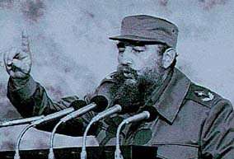
SPIRITUAL NOT RELIGIOUS
SOMEONE WHO DEDICATES HIS LIFE TO THE SERVICE OF HIS PEOPLE AND HUMANITY AS A WHOLE

Slide 74
those who abandon the poor abandons Christ
See “Fidel and Religion”
"If I were to repeat any of the sermons from the first fathers of the church [ca. 200 AD] ... about how the poor must be treated, they would say that [I am a] Maoist or Trotskyste."
Pope Francis

Slide 75
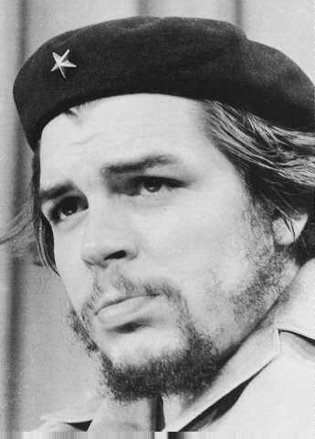
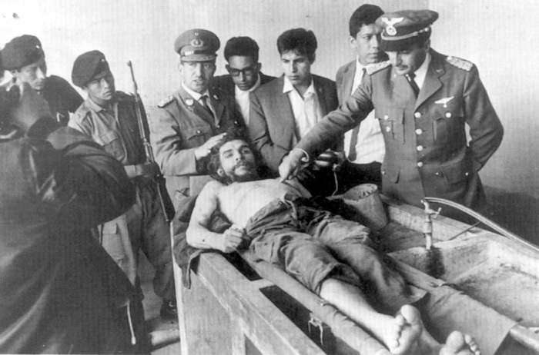
Someone who is willing to sacrifice his life to liberate the oppressed

Slide 76
“AT THE RISK OF SEEMING RIDICULOUS, LET ME SAY THAT THE TRUE REVOLUTIONARY IS GUIDED BY A GREAT FEELING OF LOVE. IT IS IMPOSSIBLE TO THINK OF A GENUINE REVOLUTIONARY LACKING THIS QUALITY... WE MUST STRIVE EVERY DAY SO THAT THIS LOVE OF LIVING HUMANITY WILL BE TRANSFORMED INTO ACTUAL DEEDS, INTO ACTS THAT SERVE AS EXAMPLES, AS A MOVING FORCE.”
Ernesto “CHE” Guevara

Slide 77
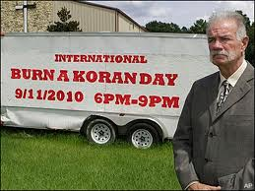
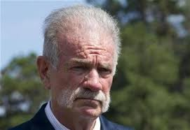
RELIGIOUS NOT SPIRITUAL
Rev. Terry Jones
promotes hatred actions against muslims
NON-DENOMINATIONAL CHARISMATIC CHRISTIAN CHURCH IN GAINESVILLE, FLORIDA
JOHN BURT
LAY PREACHER AT WHITFIELD ASSEMBLY OF GOD
INSTIGATED AND CELEBRATED PUBLICLY THE KILLING OF AN ABORTION CLINIC MD

Slide 78
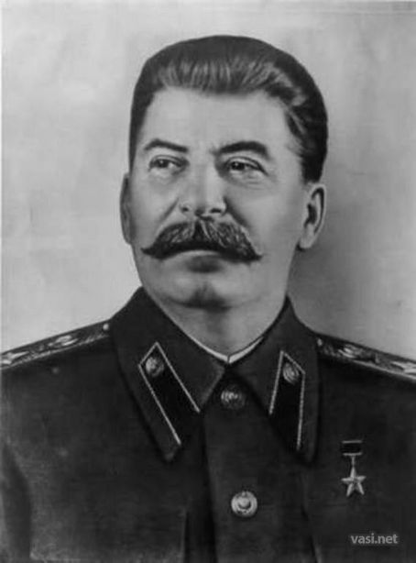
NOT RELIGIOUS NOR SPIRITUAL
UNRESTRAINED AMBITION FOR POWER USING IT FOR ABUSE AND ENSLAVEMENT

Slide 79
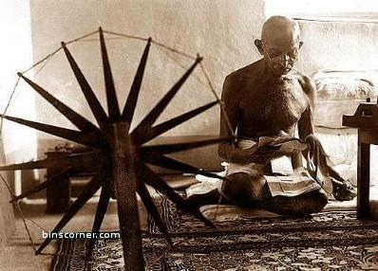
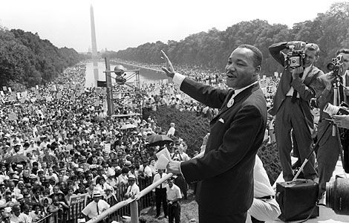
SPIRITUAL & RELIGIOUS
HINDU AND CHRISTIAN NO CONTRADICTION

Slide 80
SPIRITUAL SCIENCES
SHARE FUNDAMENTAL PRINCIPLES
LOVE, REINCARNATION, LAW OF KARMA , ASTRAL BODY ETC.
YOGA - TANTRA - SPIRITISM AYURVEDA

Slide 81
YOGA
DHARMA
(natural law)
niyamas
RULES OF PERSONAL CONDUCT
PERSONAL - MORAL TRANSFORMATION
YAMAS
RULES OF SOCIAL CONDUCT
COLLECTIVE MORAL TRANSFORMATION

Slide 82
MORAL TRANSDORMATION
OF COLLECTIVE CONSCIUOSNESS
ESTABLISHING YAMAS
RULES OF SOCIAL CONDUCT
AHIMSA, (NONVIOLENCE) SATYA. (TRUTHFULNESS) ASTEYA, (HONESTY) BRAHMACHARYA, (SELFRESTRAINT) APARIGRAHA,(NON-HOARDING

Slide 83
CONCLUSION
MORAL TRANSFORMATION THAT TRANSLATES INTO WHOLESOME WELL BALANCED INDIVIDUAL WITH INTEGRITY, SENSE OF RESPONSIBILITY AND UNDERSTANDING THE PURPOSE OF OUR LIVES AND WILLING TO LIVE A MEANINGFUL LIFE IS THE NECESSARY FOUNDATION FOR A REAL TRANSFORMATION

Slide 84
2
SOCIAL TRANSFORMATION
KINDLY BEFORE CONTINUING READ THE ARTICLES WHY SOCIALISM BY A. EINSTEIN AND SPIRITUAL SOCIALISM.

Slide 85
FOR SOCIAL TRANSFORMATION
THE PARADIGM SHIFT OR RADICAL CHANGE OF CONSCIOUSNESS OF THE INDIVIDUALS MUST TAKE PLACE NOT BY VIOLENCE BUT BY PERSONAL & COLLECTIVE HUMAN DEVELOPMENT.
an option
SPIRITUAL SOCIALISM

Slide 86
TRANSITION TO SOCIALISM
GIVEN THE MORAL TRANSFORMATION
OF A SPIRITUALLY BASED SOCIETY WITH A HIGHER LEVEL OF CONSCIOUSNESS THE ATTITUDE TOWARDS ITS FELLOW HUMAN BEINGS WILL BE REFLECTED IN ALL AREAS AS RESPECT, RESPONSIBILITY, RESOURCES MANAGEMENT ETC,

Slide 87
A NEW DEMOCRACY
A NEW PARTICIPATORY AND PROTAGONISTIC FORM OF DEMOCRACY MUST BE THE NEXT STEP FOR THE SOCIALIST SOCIETY AND REPLACE THE REPRESENTATIVE DEMOCRACY THAT HAS COMANDEERED, AND PLACED THE POWER IN A HANDFUL OF INDIVIDUALS
ELECTORAL ACTIVITY SHOULD BE A TOOL NOT AN END, ACCOUNTABILTY SHOULD RESPOND TO A MULTILEVEL AND ALL ENCOMPASSING POPULATION

Slide 88
NEW MODELS OF SOCIALISM
the american continent has become
a world laboratory for new forms of socialism. an increasing number of countries in south and central america are gearing their economy and policies in that direction with extraordinary results even though operating within the frame and under serious attacks by capitalist forces. the outstanding reduction of poverty and inequality are giving those governments sustained popular approval.

Slide 89
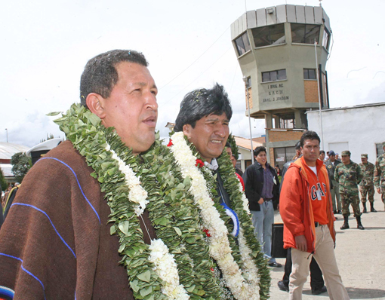
PRESENT DAY TRANSFORMATIONS
HUGO CHAVEZ
VENEZUELA
EVO MORALES
BOLIVIA

Slide 90
SOCIALIST SOCIETY
MEANS BASIC NEEDS MET
FREE OR LOW HOUSING, EDUCATION, HEALTH CARE etc.
NO FEAR OR ANXIETY ABOUT SURVIVAL
JOB OPPORTUNITIES FOE EVERYBODY.
HUMAN DEVELOPMENT FACILITATED MENTAL, EMOTIONAL PSYCHOLOGICAL HEALTH
ISOLATION AND LONELINESS ADDRESSED
MORE WHOLESOME INDIVIDUALS SPIRITUALLY AND PHYSICALLY BALANCED

Slide 91
A RENEWED SOCIETY
made of wholesome individuals product of different socioeconomic conditions will exhibit qualities related to:
work ethics, how we look at work: as a contribution to society, rather than a self-centered, self-serving means of earning a living.
how we earn our living and what kind of economic relationships we engage in determines the kind of society we choose to live in.

Slide 92
RIGHTS & RESPONSIBILITIES
in a socialist society it is the responsibility of the gifted to shoulder the weight of those deprived either by physical or mental limitations.
the downtrodden, the poor, the destitute must be incorporated into the structure of society as members with rights and obligations relative to their condition.
the socialist society must uphold all true human values and move away from selfishness, arrogance, greed and all dehumanizing ways, this is one of the fundamental principles in the operation of the new paradigm.

Slide 93
RIGHT LIVELIHOOD
every individual must be given the opportunity to earn their right livelihood --work which causes no harm or degradation, nor is useless to the build up of a spiritually and materially healthy society.
consumer goods are the god-given…consumable materials whose utilization brings about the material, moral, and spiritual betterment of the consumer. bad, impure, and worthless objects cannot be….considered as consumer goods.
Dr. Monzer Kahf –Islamic Perspective

Slide 94
“UNITY IN DIVERSITY”
AN ANCIENT AND WISE YOGA DICTUM
THAT GRANTS TO THE COLLECTIVE THE SAME FREE WILL OF THE INIDIVIDUAL. GRANTS SIMILARLY THEREFORE THE RIGHT OF SELF-DETERMINATION WITHIN THE PARAMETERS OF DHARMA, NIYAMAS AND YAMAS.
THIS DEVELOPS FULLNESS AND RICHNES THROUGH COMPLENTARY FORCES IN ACTION

Slide 95
CONCLUSION
SPIRITUALITY ALLOWS US TO WIDEN OUR UNDERSTANDIN OF THE UNIVERSE AND THE LAWS THAT GOVERN IT MUCH GREATER THAN THE LIMITING MATERIALISTIC LAWS SO FAR DISCOVERED AND WITH THAT UNDERSTANDING COMES THE REAL HUMAN VALUES THAT CAN ALLOW TO BUILD A SOCIETY OF PEACE AND HARMONY

Slide 96
3
3
FOR ECONOMIC TRANSFORMATION
PLEASE SEE STAGE II
4
POLITICAL TRANSFORMATION

Slide 97
SELF GOVERNANCE
THE FUNDAMENTAL SOCIETAL CELL - THE FAMILY - HAS SERVED ITS PURPOSE IN THE PROCESS OF EVOLUTION OF HUMAN KIND AS A WHOLE.
AS COMPLEXITY INCREASES BY POPULATION GROWTH IN PROPORTION TO RESOURCES THE COMMUNAL CELL BECOMES THE NEW LEARNING TOOL TO DEVELOP HUMAN RELATIONSHIPS

Slide 98
THE RURAL COMMUNAL CELL
MODELED ON BIODYNAMIC PRIINCIPLES SELF SUSTAINED INTENSIVE USE OF NATIVE AND SELF GENERATED RESOURCES. CONFIGGURATION CAN VARY CASE BY CASE. IDEAL MODEL SHOWED. SELF-GOVERNING. SUB-CELLS MAYBE NECESSARY.
THE URBAN COMMUNAL CELL
EITHER AN APPARTMENT BUILDING OR OF DETACHED HOUSES GROUPS SURROUNDED BY DRIVING ROADS ON THE FOUR SIDES. CO-HOUSING COMPLEXES, COMPUNDS ETC.

Slide 99
Parking
Ideal model
Beltway
Forest Area
P
Commercial
Zoning
Housing Area
Non Polluting Vehicles
Farm Land
Penetrating Roads
P
H
P
rural communal cell

Slide 100
THE POLITICAL ORGANIZATION
THE PRACTICE OF SELF-GOVERNANCE MUST START AT THE BASIC CELL UNITS ASSUMING SOCIETAL RESPONSIBILITY TO SATISFY THE BASIC NEEDS OF THE TOTALITY OF THE CORRESPONDING CELL.
MUST MOVE FROM THE PERIPHERY TO THE CENTER. THAT MEANS THE COMMUNAL CELL FROM THE COUNTRY SIDE AN THE PERIPHERAL CITIES TOWARDS THE URBAN CENTERS OF POWER WHO SHOULD PROVIDE THE NECESSARY SUPPORT.

Slide 101
ORGANIZATIONAL DEVELOPMENT
CONGLOMERATE OF CELLS WILL BE ON THEIR TURN GROUPED TOGETHER BASED ON AVAILABILITY OF SERVICES, SIZE OF THE POPULATION, SELF DETERMINATION OF THE POPULATION ETC. UNTIL THESE ISSUES ARE RESOLVED THE EXISTING CONDITIONS WILL BE MAINTAINED.
ASSEMBLIES ORGANIZED IN SIMILAR MANNER WILL NOMINATE DELEGATES FORMING INCREASING LEVELS UNTIL GETTING TO THE NATIONAL LEVEL

Slide 102
POLARIZATION
USING THE THEORY OF MASTER O.M.A. WHEN A POLARIZATION HAPPENS, WE CAN GENERATE A DIFFERENT DYNAMIC
CAPITALISTS MENTALITY
ABYSS
ABYSS
SOCIALISTS MENTALITY

Slide 103
MONEY
WON’T BE DEFIED ANYMORE BUT USED AS IT WAS MEANT TO BE A TRANSACTIONS TOOL.
NOT ALLOWED FOR POLITICAL CAMPAIGNS ALL GOVERNMENT FINANCED.

Slide 104
FOR THE TRANSFORMATION
JOIN THE OPPOSING FORCES WITH THE POWER OF LOVE. AND GOD AT THE CENTER
CAPITALIST MENTALITY
LOVE
GOD
LOVE
SOCIALIST MENTALITY

Slide 105
GLOBAL COALITION FOR PEACE
REMOVE ROCKS, WEEDS, DEBRIS AND WITH MUCH CARE AND RESPECT. HEAL THE SOIL WITH THE APROPRIATE REMEDIES AND NUTRIENTS TO RESTORE ITS VITALITY. WAIT FOR THE RIGHT SEASON TO PLANT THE SEEDS THAT WILL BEAR FOOD FOR THE TEMPLE OF THE SPIRIT-
YOUR BODY!
SATTWIC PEACE GARDENS ARE THE MODEL THAT REMINDS US TO APPLY THIS CONCEPT FOR ANY HUMAN ENDEAVOR.
105

